Slide 1

Video and Screen Sharing Application- FINAL PRESENTATION
Vineeth Mohan Edukulla
Haritha Andem
Saikrishna Kyatam
Abinash Banda

Slide 2
Introduction
Video and screen sharing is an application where one person can share their computer's desktop or want to communicates with another person. It generally serves one of three purposes: Quick collaboration and meetings between co-workers. Client communications, such as sharing a presentation or other applications.
The application provides real-time Peer-To-Peer streaming between two clients.
your browser will directly stream audio & video to another participant’s browser without any server in between which results in low latency.
We are using WebRtc to add real-time communication capabilities to our application that works on top of an open standard. It supports video, voice, and generic data to be sent between peers, allowing developers to build powerful voice- and video communication solutions.

Slide 3

Application Development Modules
-Development of JavaScript code to access the camera, microphone, and screen data and display to the user interface.
-Development of HTML, CSS, JavaScript code for client-side user interface.
-Development of Remote API call to STUN server to get the unique IP address.
-Development of Remote API connection to another client.
-Development of code to retrieve the other client data and display it on the clients’ web application.

Slide 4
Technologies in usage
Web Real-Time Communication
Fire store database on the server
Encryption

Slide 5
Project Implementation
Accomplished tasks
In this project, we first hosted Google's fire store database.
Once the database setup is completed, developed JavaScript code on the client-side to connect to the stunt server and retrieve the Unique identification of his system.
After retrieving the IP address, the ice candidate's data (Offer candidates and Answer Candidates ) is pushed into the fire store database.
Developed user interface to share video or screen using the web application and hosted the web application in vite server.
Developed code to receive permissions from users to share his video or screen and then displayed it on the web application.

Slide 6
Project Implementation Accomplished tasks
Developed code to connect to other clients using the unique IP address stored in the fire store database.
After connecting, we will be retrieving the data and displaying it on the user interface.
The same protocol is followed for accessing the screen-sharing data as well.

Slide 7
Architecture and components
Clients
STUN Server
Signaling Server(javascript and fire store database)
Internet Protocol

Slide 8
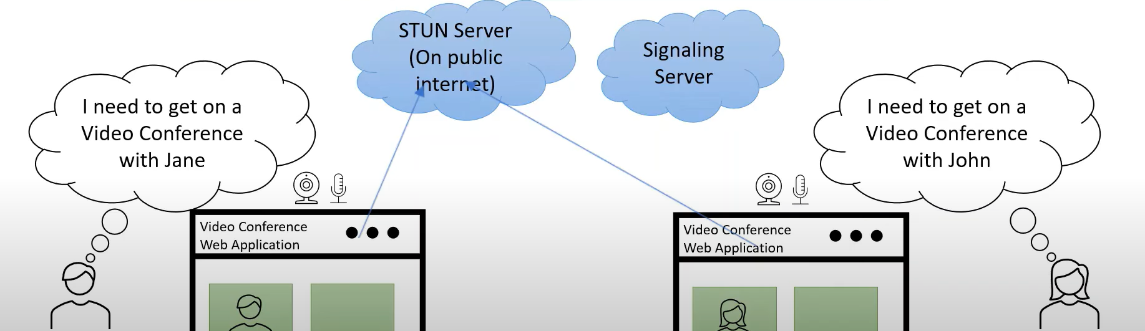
Architecture

Slide 9
TOOLS AND Softwares used
HTML CSS JAVASCIPT VANILLAJS– FRONT END
FRONT END HOSTED ON VITE SERVER
GOOGLE’S FIRE STORE DATABASE.

Slide 10
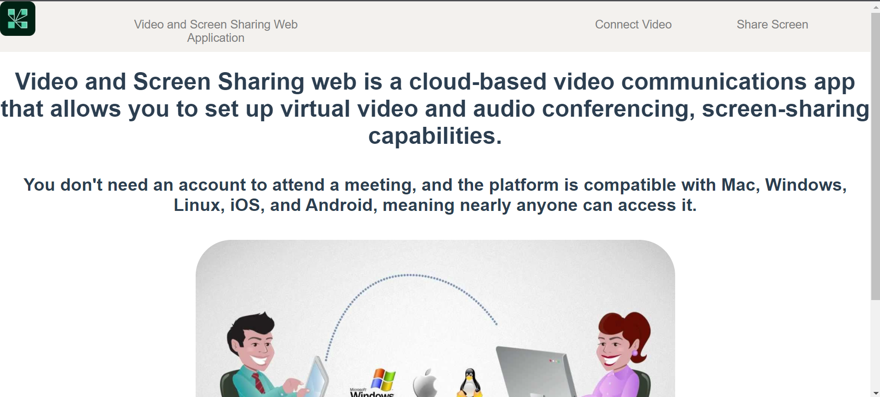
PROJECT- USER INTERFACE

Slide 11
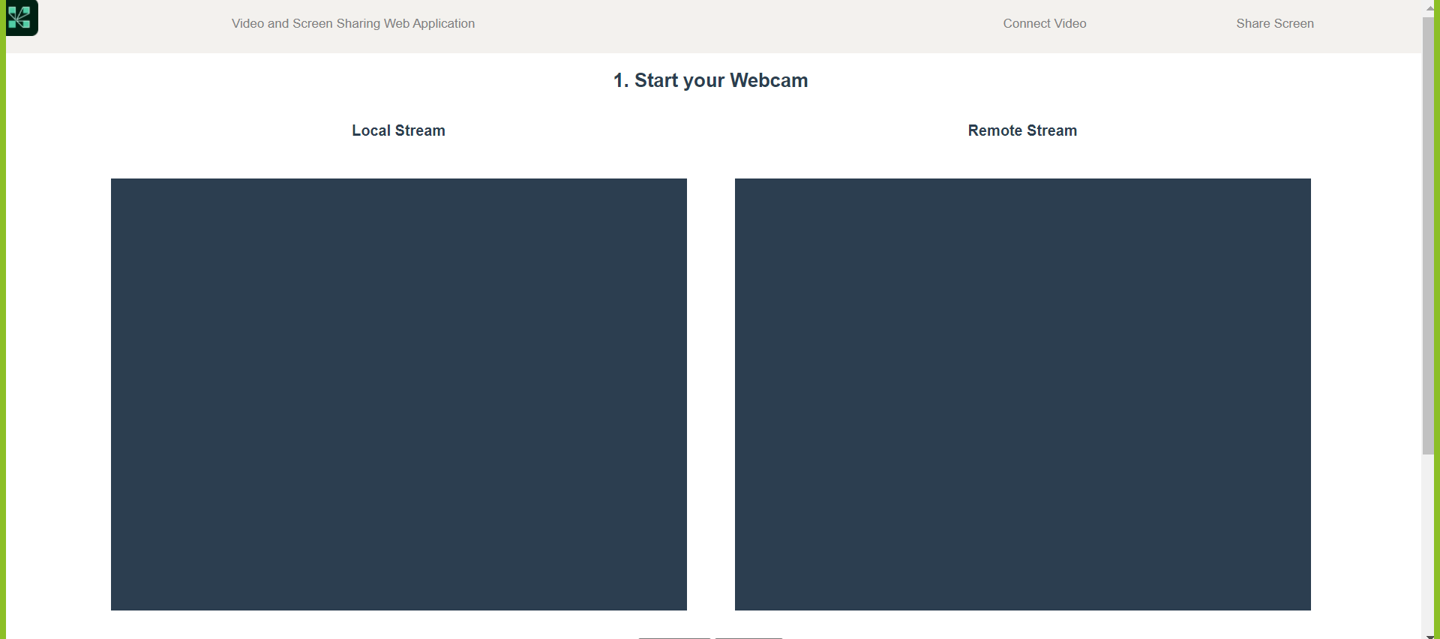
VIDEO SHARING

Slide 12
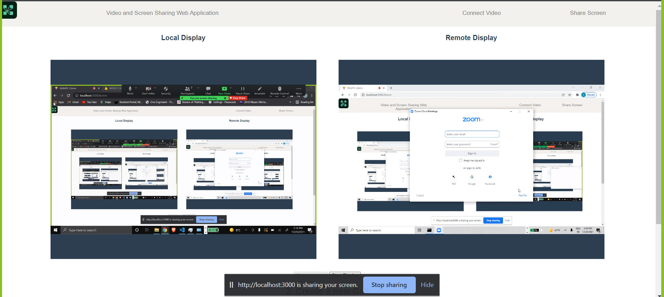
SCREEN SHARING

Slide 13
REferences
https://webrtc.org/
https://developer.mozilla.org/en-US/docs/Web/API/WebRTC_API
https://vitejs.dev/guide/
https://firebase.google.com/products/firestore?gclid=Cj0KCQiA8ICOBhDmARIsAEGI6o0e32HazMClJn_giENN2VEqCfJTXisvnHPHI2vImqndQZIfZnrNqgcaAnHoEALw_wcB&gclsrc=aw.ds
https://medium.com/@otacorporation0520/set-up-stun-turn-server-for-the-video-chat-app-ee8dc6fb9b15
https://medium.com/firebase-developers/cloud-firestore-basics-in-android-98ccabbc949b
https://www.wowza.com/blog/webrtc-encryption-and-security

Slide 14
Thank you

